Slide 1
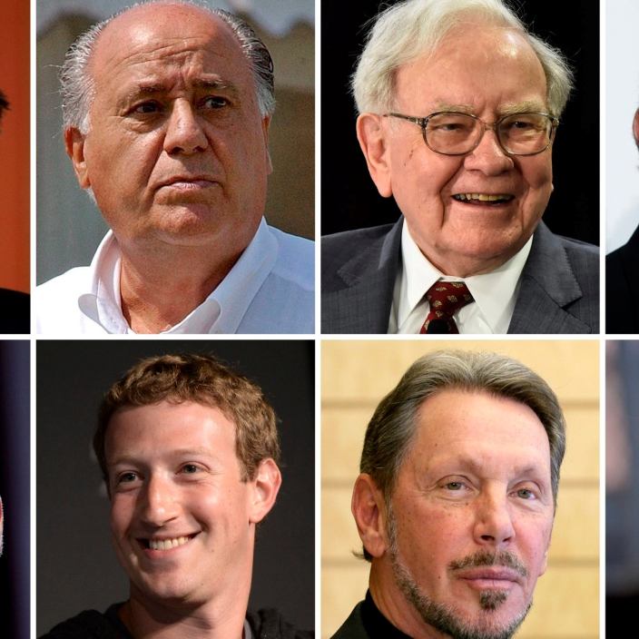




WORLD’S Billionaires
DATA ANALYSIS & VISUALIZATION
PROJECT 2 – GROUP 5
DATE: 24/03/2022

Slide 2


MEMBERS: Anh huong DANIELA CORNEA MINO PERIC

Slide 3

Scope and methods
Scope
Analyze and visualize world’s billionaires' data
Tools and Methods
Python
Flask/API
HTML/CSS
JavaScript
SQL/MongoDB
D3, Leaflet, Dimple

Slide 4
MAIN Datasets
Forbes Billionaires of 2021 – Version 1
https://www.kaggle.com/roysouravcu/forbes-billionaires-of-2021
Forbes Billionaires of 2021 – Version 2
https://www.kaggle.com/alexanderbader/forbes-billionaires-2021-30/version/3
Forbes Real-time Billionaires
https://www.forbes.com/real-time-billionaires
Project Proposal & Schedule
https://docs.google.com/document/d/1JCnSdtQzhU7XK9pdG8AwAn8fc7UkFT1tGiuKjaySkRw/edit

Slide 5
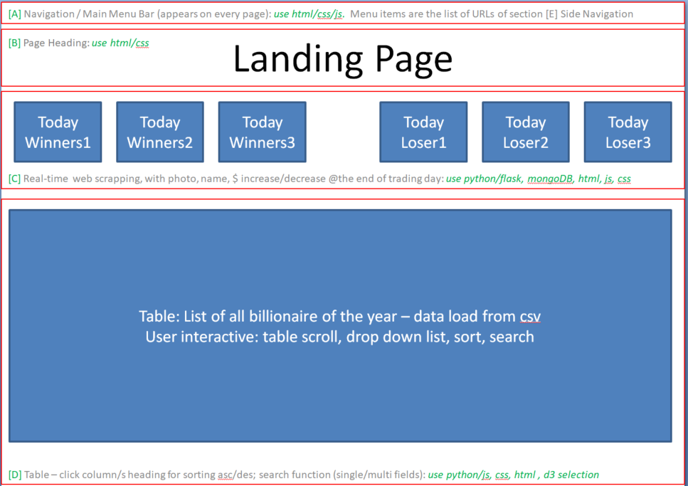
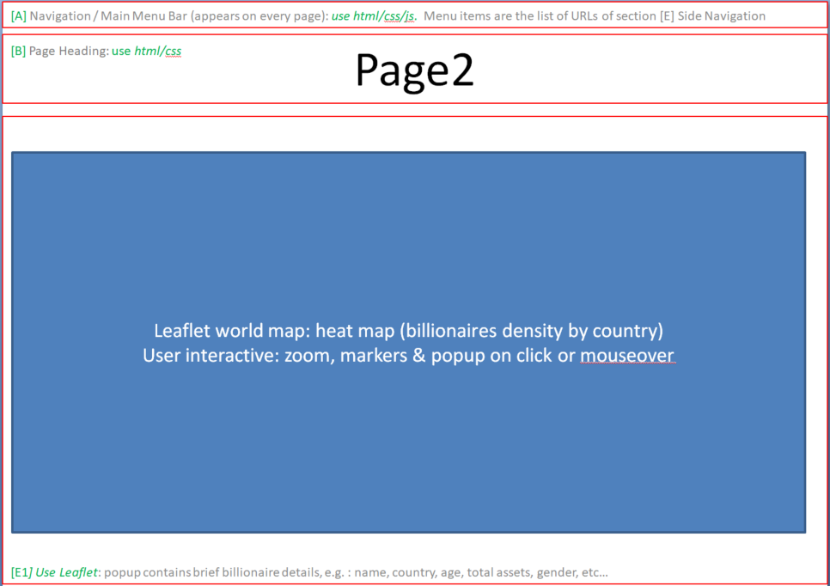
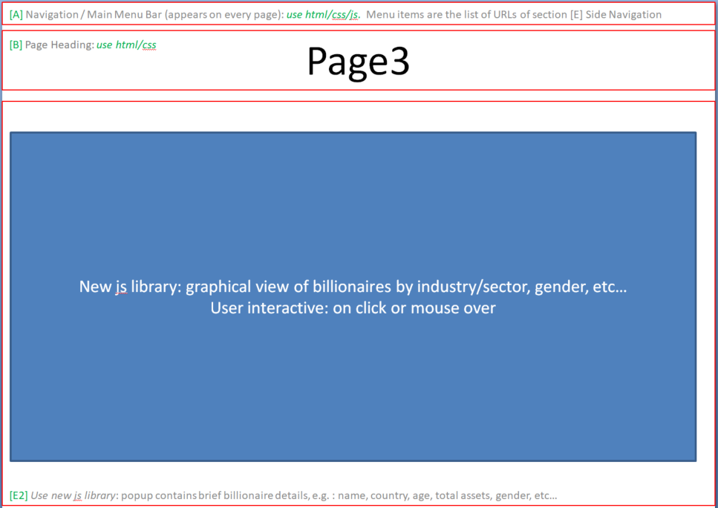
High level design
Conceptually design: - the end view of the product
scalable solution, how each component of the app should look like
techniques apply on each component with work allocation

Slide 6
APP development
Data extract, cleanse, transform and load
Design, coding & test individual components
Merge: codes, components and perform end-to-end testing
Deploy codes

Slide 7
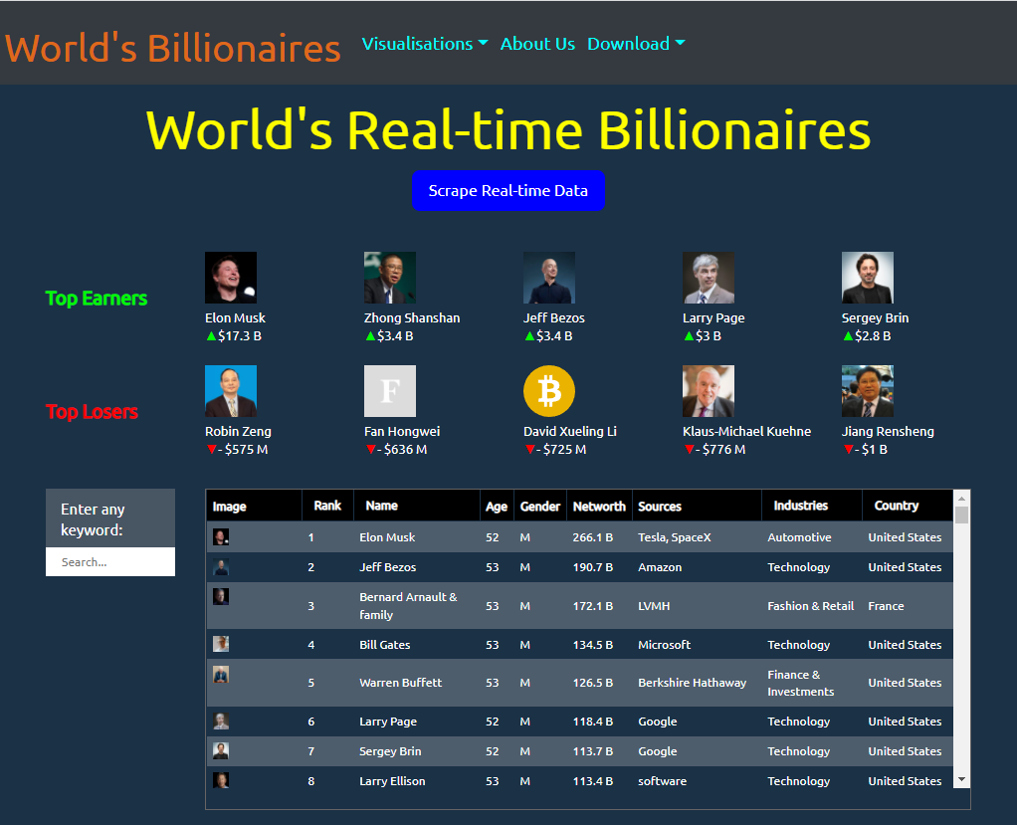
Billionaires APP

Slide 8
Landing Page
Data scraping from Forbes (in real-time) using: Python, Flask API, MongoDB, JS, HTML, CSS.
User interaction: Scraping button, zooming, sorting data in column: Rank, Name, Industries and Country, keyword search (on any column). Top Navigation bar to navigate around the app.

Slide 9
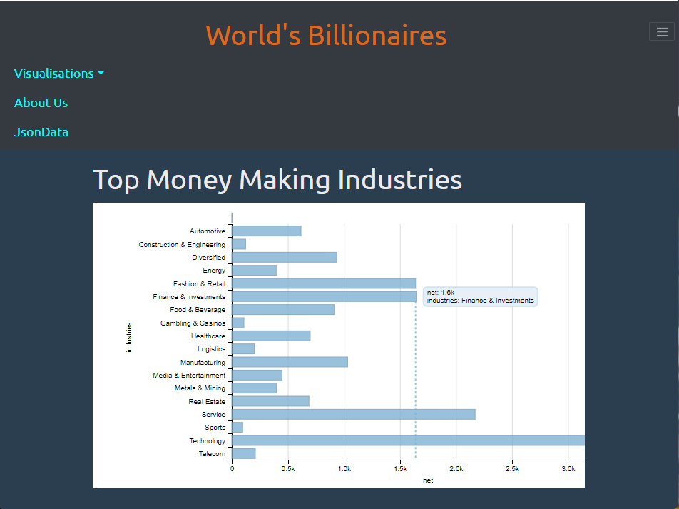
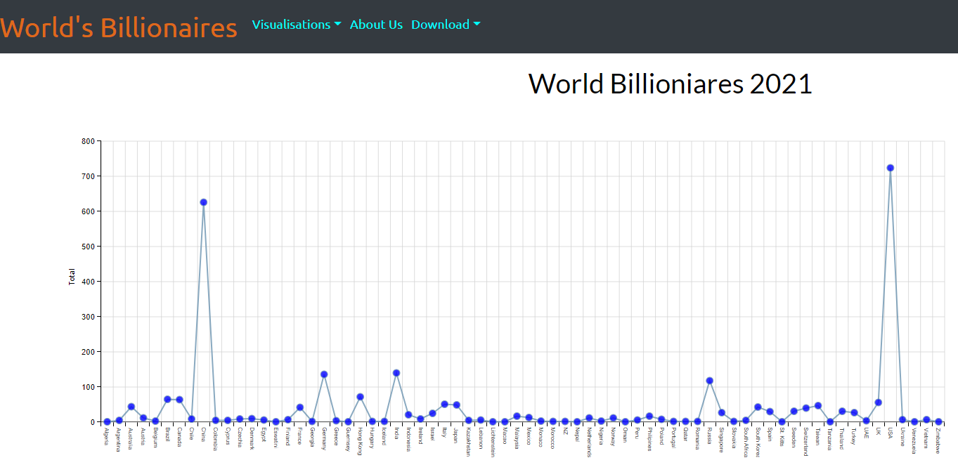
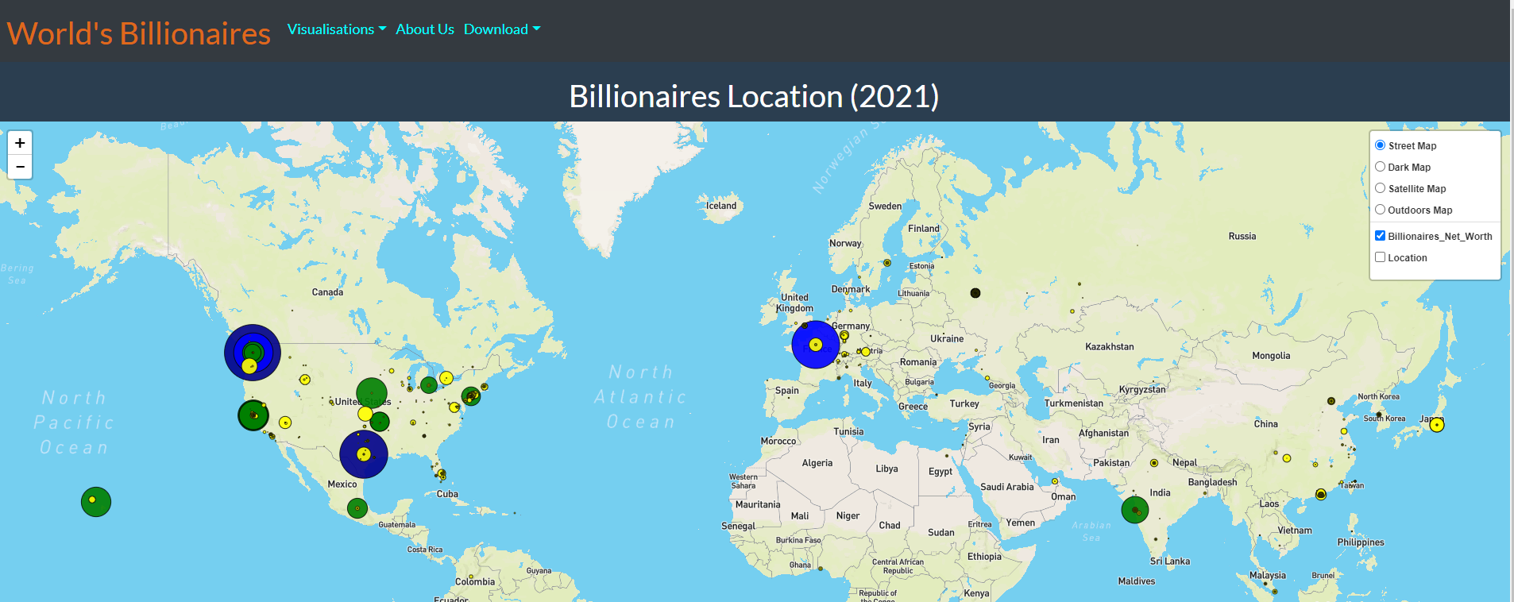
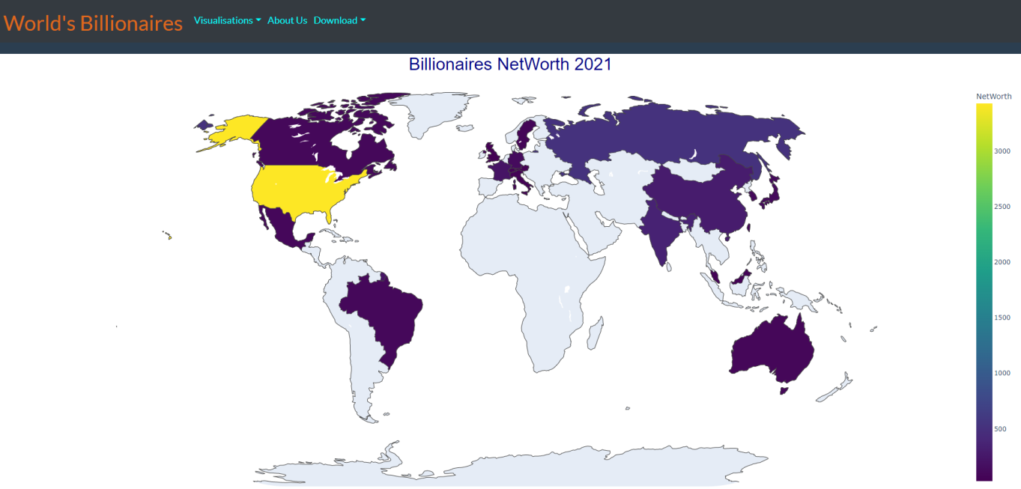
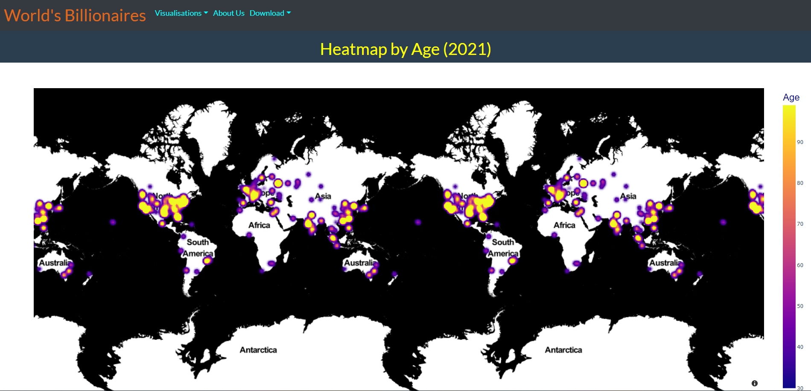
Visualisation

Slide 10
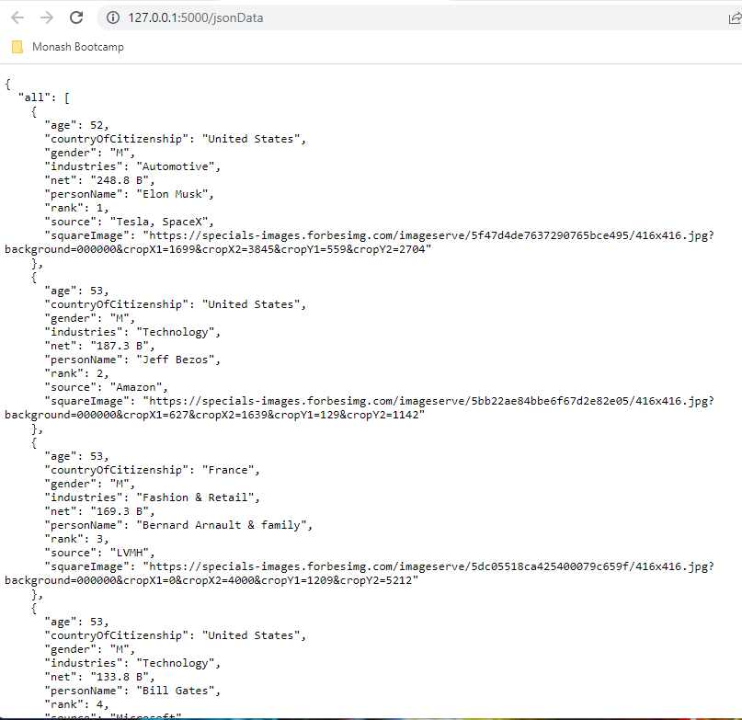
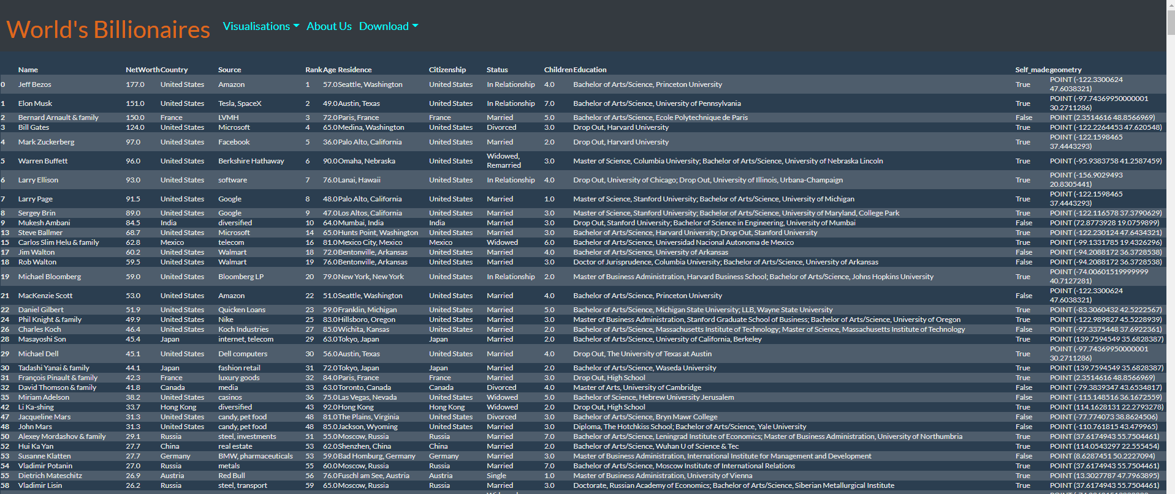
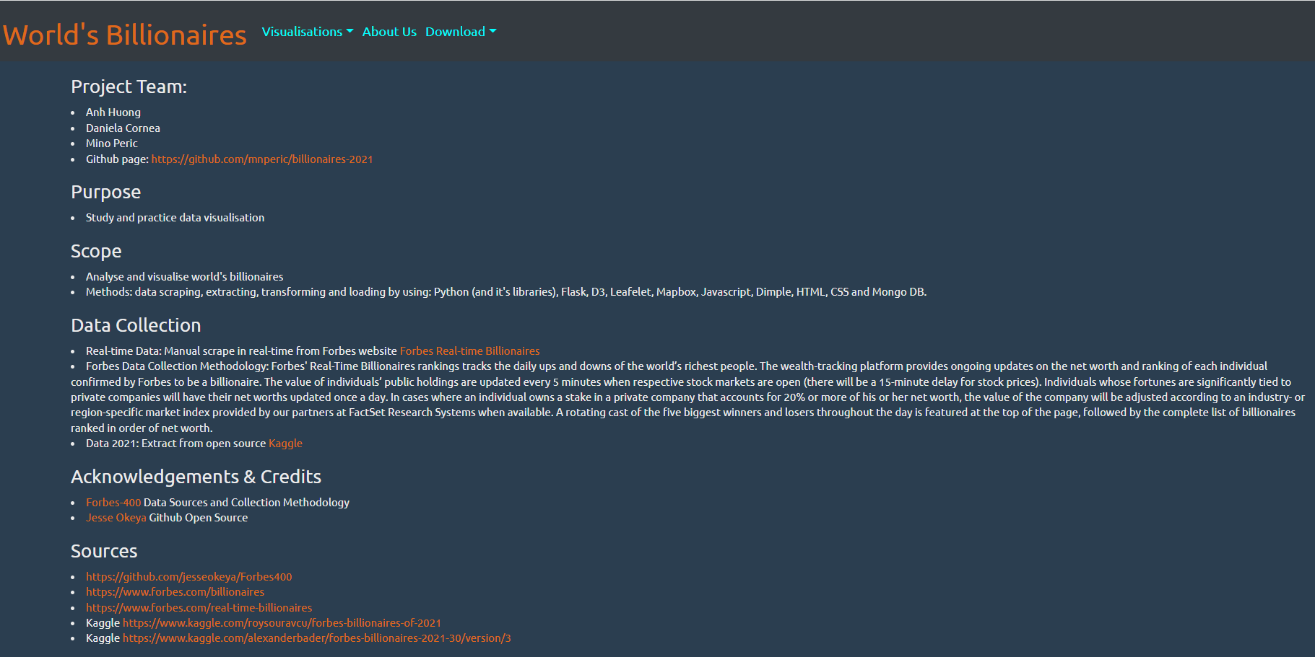
USABILITY & ACKNOWLEDGEMENT
Data Available for download: Json and tabular format
Acknowledgement & Credits page

Slide 11
Challenges
Technical Challenges:
Heroku deployment: Heroku stopped support MongoDB
Page navigation using Flask
Find a suitable new JS library for the datasets
Find data with Geojson format that can be used for Leaflet
Team Challenges:
A member got dropped off 2 days ago with no deliverables
Communication & availability

Slide 12
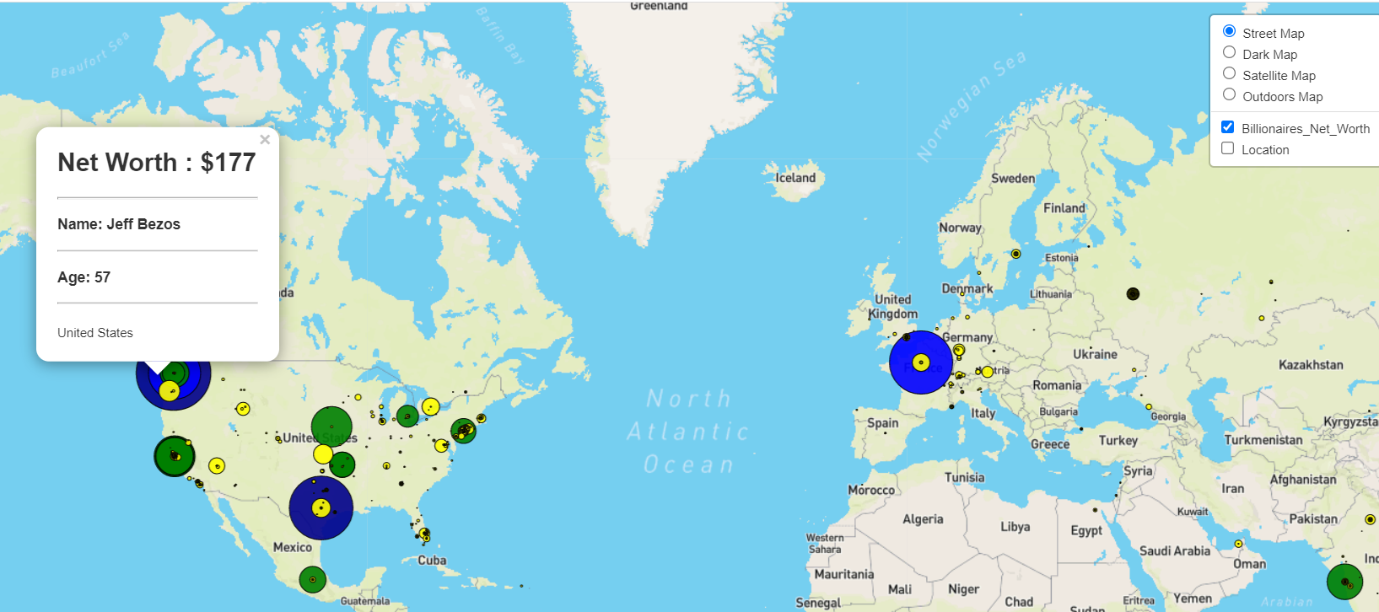
leaflet
Use Leaflet to visualize net worth of billionaires on various Mapbox layers
Allow user to choose the layer and the way the data is displayed
Use markers with adjusted size and color for the value of the net worth

Slide 13
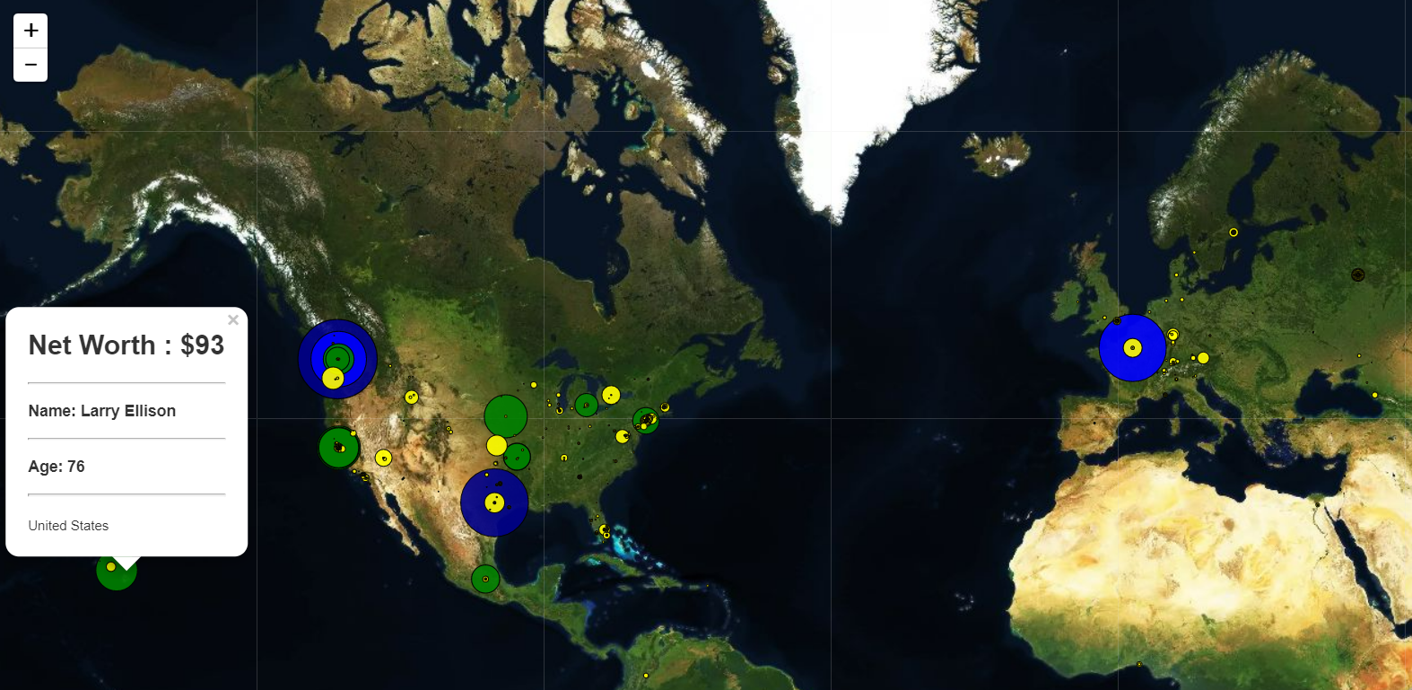
leaflet
Satellite map
Net worth markers color: dark blue $150+, blue $150, green $100, yellow $50, gold $1-
Markers size linked to the value of the net worth

Slide 14
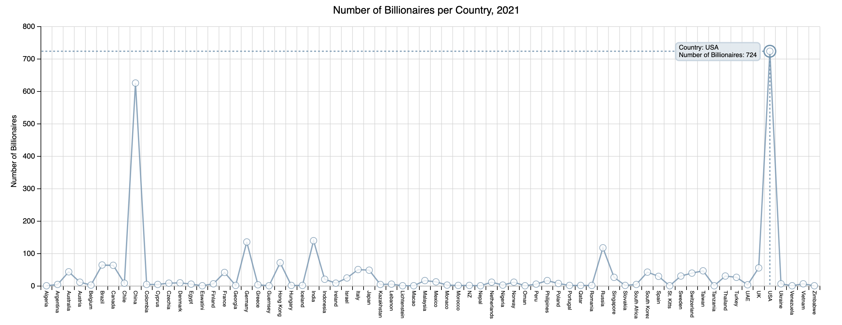
NUMBER OF BILLIONAIRES PER COUNTRY
Calculated total Billionaires for each country, USA (724), China (626), India (140)
Utilised Dimple.js – visualise Number of countries with Billionaires, Number per country
Further study – Number per country per pop., Number per capita, Number per industry

Slide 15
LIVE app DEMONSTRATION

